Slide 1
PC Maintenance: Preparing for A+ Certification
Chapter 21: Networking Hardware Concepts

Slide 2
Chapter 21 Objectives
Identify networking topologies
List common wired networking standards
List common wireless networking standards
Describe hardware needed to create a network

Slide 3
Resources Shared on a Network
Hard disk space
Disk drives (CD-ROM, ZIP)
Printer access
Internet access
  DSL/Cable Router
  Internet Connection Sharing

Slide 4
LAN versus WAN
Local Area Network (LAN)
  Confined to a small area such as a building
Wide Area Network (WAN)
  Networking on a much larger geographical scale (ex. the Internet)

Slide 5
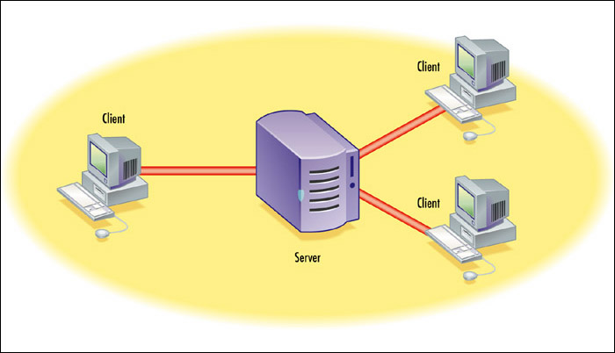
Client/Server Networking
Server: PC that exists to provide network services
Client: End-user PC or device
Client/Server: Network that contains both clients and servers

Slide 6
Peer to Peer Networking
All clients (no servers)
All PCs share networking burden
No server software needed
Works well for very small networks (under 10 computers)
Becomes cumbersome with larger numbers

Slide 7
Physical Topologies
Bus
Ring
Star
Mesh

Slide 8
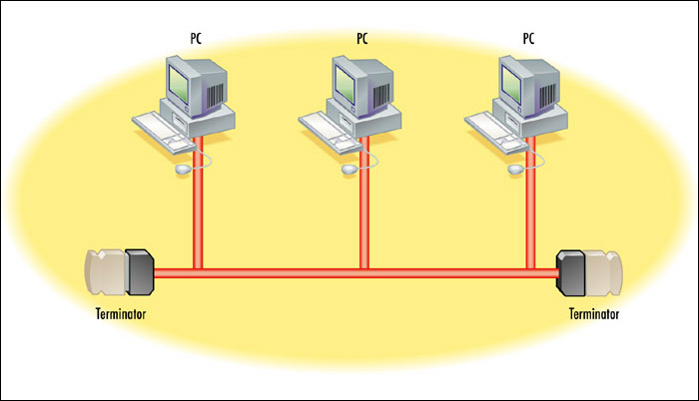
Bus Topology
No longer widely used. 10Base2 and 10Base5 were examples.

Slide 9
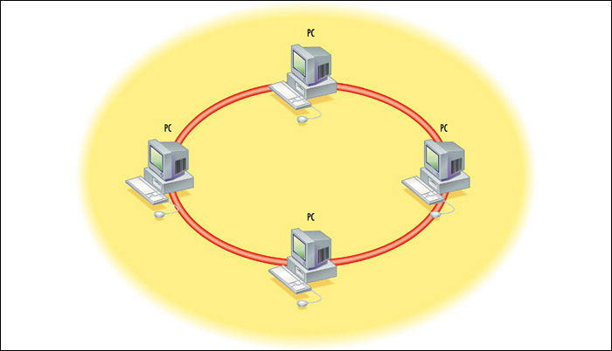
Ring Topology
Older; no longer commonly used as a physical arrangement

Slide 10
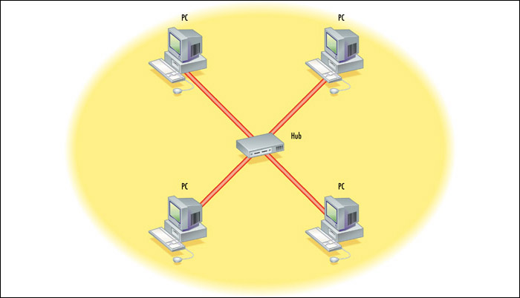
Star Topology
Most common physical topology in use today

Slide 11
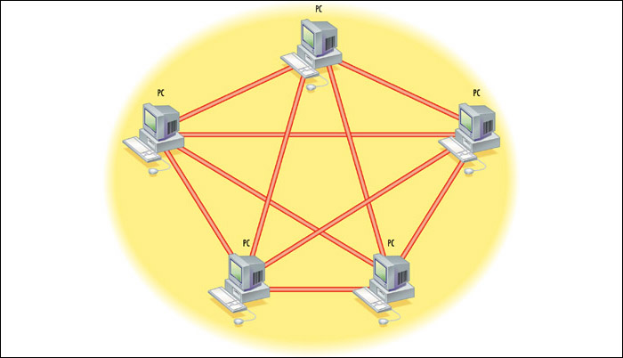
Mesh Topology
Physical topology used on the Internet

Slide 12
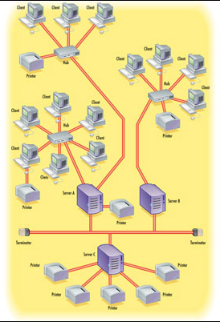
Hybrids
Most networks of medium or large size use a combination of physical topologies
A star-bus combination is shown here

Slide 13
Logical Topologies
Logical refers to the way information is passed on the network
  For example, if the physical topology represents the streets in a town, the logical topology would represent the mail carrier’s route
Logical topologies: star, ring, bus
Logical topology need not match the physical topology

Slide 14
Ethernet
Most popular networking standard
Logically a bus
Physically a star, ring, or hybrid
Can be wired or wireless
Can use copper wire or fiber optic cable

Slide 15
Some Ethernet Types
1000BaseT (Gigabit Ethernet)
100BaseT (Fast Ethernet)
10BaseT, 10Mbps
10Base-2 (Thinnet)
10Base-5 (Thicknet)
Wireless Ethernet
  802.11a, 802.11b, 802.11g
10BaseFL, 10BaseFX

Slide 16
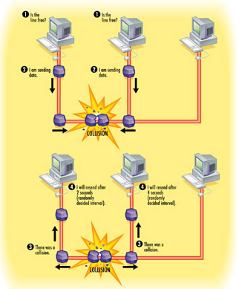
Collision Avoidance in Ethernet
Carrier Sense Multiple Access/Collision Detection (CSMA/CD)
Collision detected and retry occurs at random time

Slide 17
Wireless Ethernet
Also called Wi-Fi
802.11b: up to 11Mbps, very popular, range of 250 to 300 feet
802.11g: up to 54Mbps, backward-compatible with 802.11b
802.11a: up to 54Mbps, not compatible with 802.11b

Slide 18
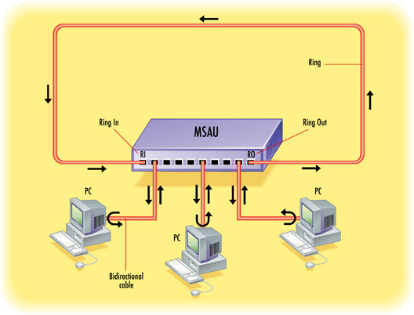
Token Ring Networking
Physically a star: Multistation Access Unit (MSAU)
Logically a ring

Slide 19
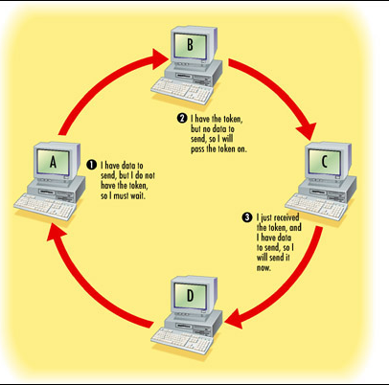
Collision Avoidance in Token Ring
Only the PC with the token can send data

Slide 20
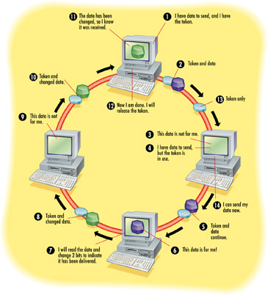
Token Passing

Slide 21
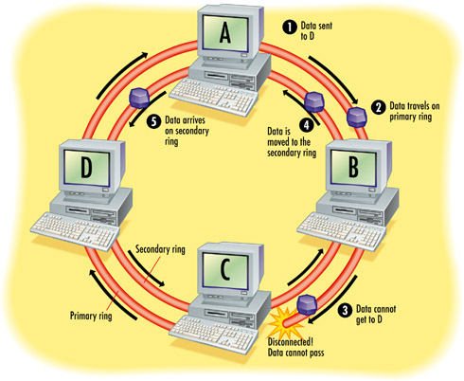
FDDI Network – Dual Ring

Slide 22
Data Packets
Packet contains data plus header and footer
Header specifies destination and protocols used
Footer contains error-checking information

Slide 23
OSI Layers
Open Systems Interconnection
Reference model for discussing networking
Explains how a network operates
Helps when troubleshooting network problems

Slide 24
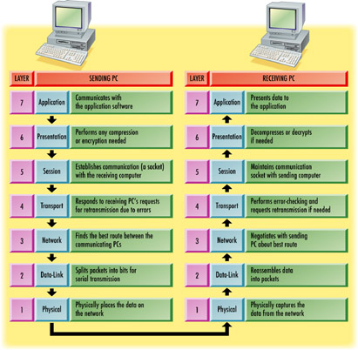
OSI Layers

Slide 25
Network Protocols
Protocol: An agreed-upon language for transmitting data between devices
Example: TCP/IP
  TCP operates at Transport level
  IP operates at Network level
Example: FTP
  Operates at Presentation and Application level

Slide 26
Network Interface Card (NIC)
Choose correct model for network type
  Ethernet
    Wired (10/100BaseT, 1000BaseT)
    Wireless (802.11a, b, g)
  Token Ring
Choose correct model for bus to be used
  PCI
  ISA
  USB

Slide 27
MAC Address
Hard-coded address in NIC
6-byte hexadecimal number
No two in the world have the same MAC
First three bytes indicate manufacturer
Second three bytes are ID number

Slide 28
Connecting Devices
Hubs
Switches
Multi-Station Access Units (MSAUs)
Routers
Bridges

Slide 29
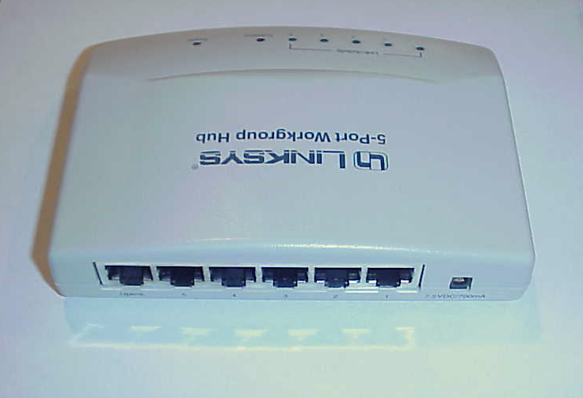
Hub
A physical gathering point for cables from NICs
Dumb, does not evaluate addressing
Sends same message to all connected nodes
Speed to each node decreases with each node connected
Wireless models are called “Access Points”

Slide 30
Switch
A smart version of a hub
Evaluates addressing and sends packets only to addressee
Attaching more nodes does not split speed
Replacing hubs in popularity because of superior performance

Slide 31
Multi-Station Access Unit
Used in Token Ring networking
Physically looks like a hub or switch
Logically conducts packets in a ring

Slide 32
Router
Reads IP addresses
Routes packets between subnetworks
Physically looks like a hub or switch
Allows home users to share cable or DSL Internet
Routers used extensively on Internet
Both wired and wireless models available

Slide 33
Bridges and Gateways
Bridge: Connector between two physically dissimilar networks
  Wired Ethernet to wireless Ethernet
  Phone line Ethernet to 100BaseT Ethernet
Gateway: Connector between two logically dissimilar networks
  Token ring to Ethernet
  Ethernet to Apple network

Slide 34
Wireless Networking Hardware
Similar to wired equivalents
Standards
  802.11a
  802.11b
  802.11g
Security is an issue
  Wired Equivalent Privacy (WEP)

